Slide 1
Lecture 1 – Machine leanring basics
AI in Genetics
ZOO6927 / BOT6935 / ZOO4926

Slide 2
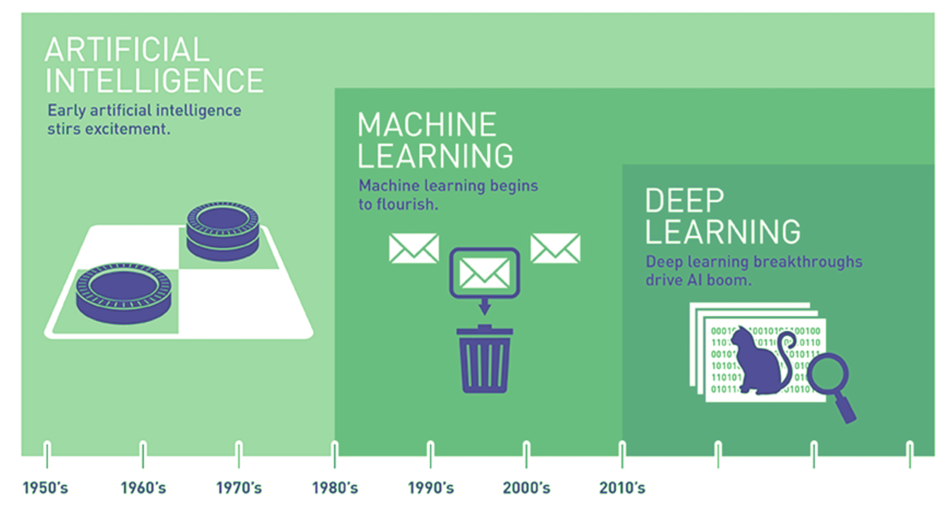

The AI landscape
Source: Copeland, M. Retrieve from https://blogs.nvidia.com/blog/2016/07/29/whats-difference-artificial-intelligence-machine-learning-deep-learning-ai/
Notes:
The field of AI is expansive…
Often, the terms AI, Machine Learning, and Deep Learning are used interchangeably. But as pictured here, they are nested subsets, with AI encompassing the other two. Indeed, AI has a long and distinguished history. In fact, a lot of interesting AI research happened in the 1950s. Unfortunately, though, progress has been uneven – as we will soon see.
Let’s take a closer look at the history of machine learning and deep learning.
[NEXT SLIDE]
=====
Expansive AI
AI encompasses ML and DL
Distinct domains
Uneven progress since the 1950’s, with multiple ‘winters’ where interest and funding dried up
Let’s first examine the relationship between machine learning and deep learning.

Slide 3
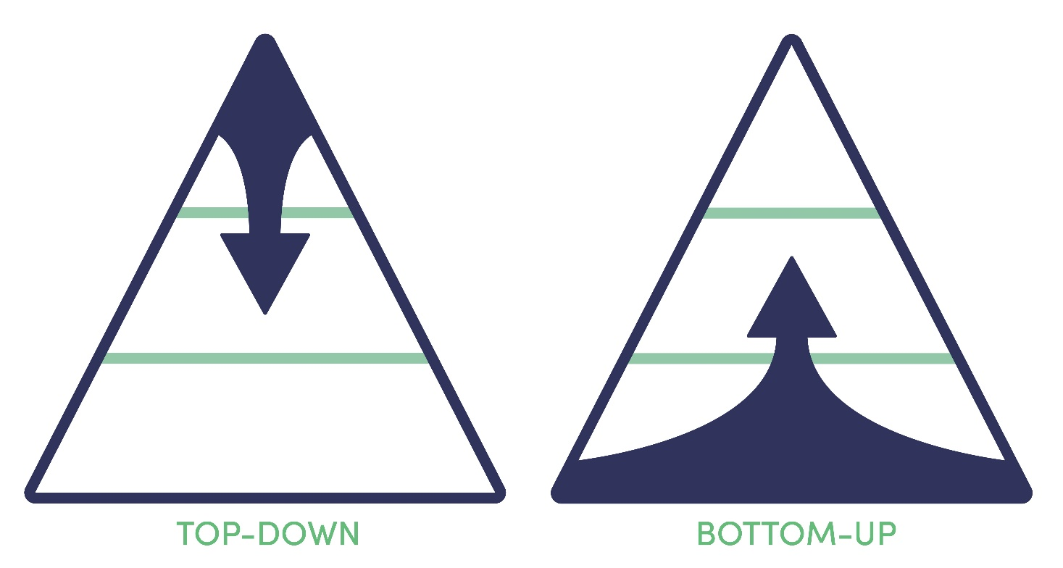
Notes:
Historically, AI researchers have taken two fundamental different approaches to the creation of learning machines. Both have a long and distinguished history, having been developed in the 1950’s, 60’s, and 70’s. These two approaches can be classified as either top-down or bottom-up.

Slide 4

Notes:
I will first consider top-down approaches. These have the following characteristics:
Focus on knowledge, problem decomposition, symbolic (abstract) reasoning, and problem-solving algorithms.
With this approach, AI is achieved through direct engineering.
And a couple examples should clarify these points…

Slide 5
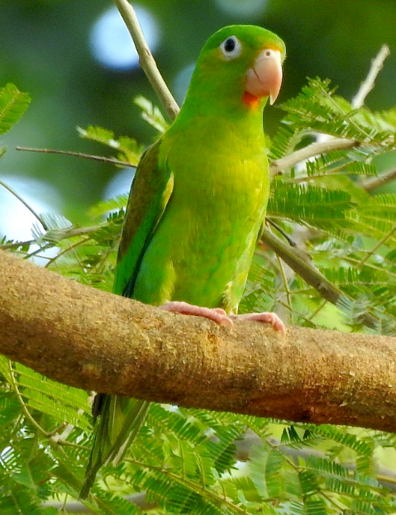
Can the orange-chinned parakeet fly?
Laura Gaudette (CC-BY)
Knowledge base
Birds can fly (0.99).
A parrot is a bird.
The orange-chinned parakeet is a parrot.
…
Q: Can the orange-chinned parakeet fly?
Inference Engine
A: The orange-chinned parakeet most likely can fly.
Notes:
In our first top-down example, we ask an expert system a question.
Can the orange-chinned parakeet fly?
To answer that question, we first model our knowledge in a knowledge base, consisting of a set of interconnected propositions, also called heuristics or rules of thumb.
At the heart of our expert system lies an inference engine capable of applying logical rules to our knowledge base to deduce new information.
We then present our question to the inference engine – “Can the orange-chinned parakeet fly”
The inference engine, in turn, queries the knowledge base, and uses its internal logic to…
… respond with an answer.
Expert systems were popular in the late 1980’s, with most systems being developed in the Lisp or Prolog programming languages.
-- Orange-chinned parakeet
-- Inference engine.
-- A’s and e’s.

Slide 6
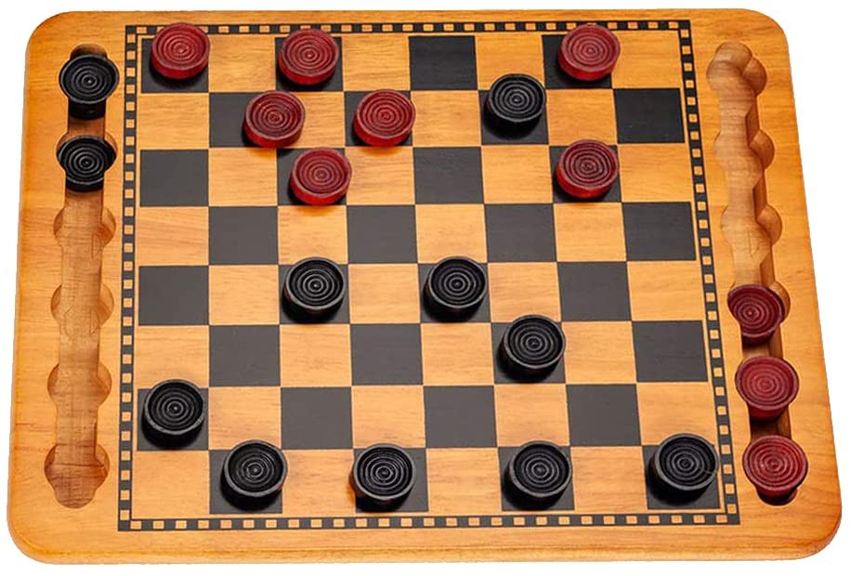
What is red's next move?
Game tree search
next move
Game board representation
Position evaluator
Rule-based pruning
Notes:
In our second top-down example, we’ll examine an AI system capable of playing checkers.
In this case, we want the AI system to calculate red’s next move.
To figure that out, the game state and position of each piece is modelled in a data structure called the game board representation.
… that game board representation is fed to a position evaluator…
as well as the game tree search algorithm which, in turn…
queries the position evaluator.
Prunes the search tree
And responds with a move.
The idea of intelligent machines playing games is not new. In fact, Arthur Samuel wrote a program that could play checkers in 1959.
-- Game board representation.

Slide 7
Top-Down (Summary)
Notes:
These two examples of the top-down approach to AI can be summarized as follows:
Focus on knowledge representation, problem decomposition, symbolic reasoning, and problem-solving algorithms.
These are examples of “common sense” reasoning – playing checkers, arriving at conclusions, given a set of propositions.
Most of these systems work because the rules of deductive logic govern their operation. That is – if the premises are true – the conclusion follows.
All men are mortal – Socrates is a man – Therefore Socrates is mortal
AI is achieved through direct engineering w/Prolog or LISP

Slide 8

Notes:
Let’s now turn our attention to the bottom-up approach to AI. With this approach, the focus is on inputs (the data, the environment, etc…) as well as low-level processing. AI is achieved via learning, self-organization, or optimization.

Slide 9
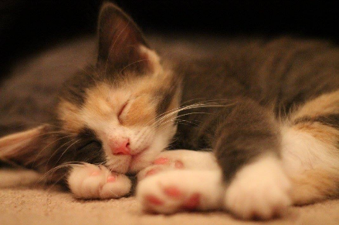

Cat or Dog?
Mathematical function mapping image to label (“cat” or “dog”)
cat
Notes:
Our bottom-up example will be a simple classification task – Is this an image of a dog or a cat?
We start with a mathematical function capable of mapping an image to its corresponding label.
We then present the function with an image and it, in turn, responds
with a prediction – that this image is a cat.
-- Slow down the word image…

Slide 10
Artificial Intelligence
Top-Down
(Symbolic AI)
Bottom-Up
Logic-based systems
Expert systems
Knowledge representation
Machine reasoning
Machine Learning
Regression
Support Vector Machines
Tree-Based Methods
Deep Learning
Neural Networks
Notes:
Finally, let’s summarize what was covered in this briefing. As we learned, AI is a broad field of study with two distinct approaches to intelligence. In the first part of this briefing, I talked about the top-down approach to AI. Now keep in mind that top-down or symbolic AI systems do not learn. In other words, all the knowledge the system needs to function is built into it upfront.
That is not the case with bottom-up approaches to AI. In fact, machine learning is the sub-field of AI that uses statistical methods which enable systems to learn from data. And within machine learning lies the sub-field of deep learning where the focus is neural networks – a neural network being a special kind of algorithm, inspired by the billions of connected neurons in the human brain.
=====
Two approaches – top-down vs. bottom-up
Top-down (symbolic) AI systems do not learn – knowledge modelling – 1980s / 1990s – heuristics / rules of thumb – Prolog or Lisp
Bottom-up AI systems, on the other hand, can learn.
Neural networks are the key feature of deep learning systems.
Machine learning is a broad field and includes non-neural approaches to AI.

Slide 11
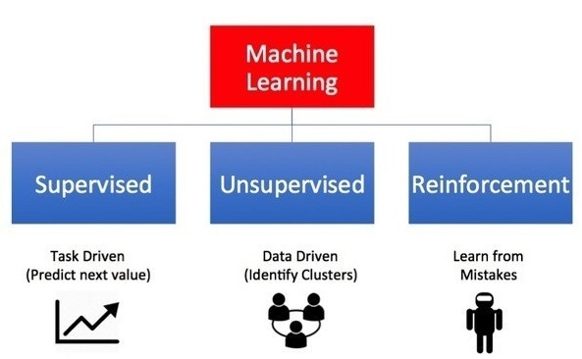
The Machine Learning landscape
Machine
Learning
Supervised
Unsupervised
Reinforcement
Task Driven
(Predict next value)
Data Driven
(Identify Clusters)
Learn from
Mistakes
Image Credit: https://towardsdatascience.com/what-are-the-types-of-machine-learning-e2b9e5d1756f
Notes:
There are three principal types of machine learning systems (supervised, unsupervised, and reinforcement).
Supervised Learning is Task Driven (Predict next value)
Unsupervised Learning is Data Driven (Identify Clusters)
Reinforcement Learning is Experience Driven (Learn from Mistakes)
[NEXT SLIDE]

Slide 12
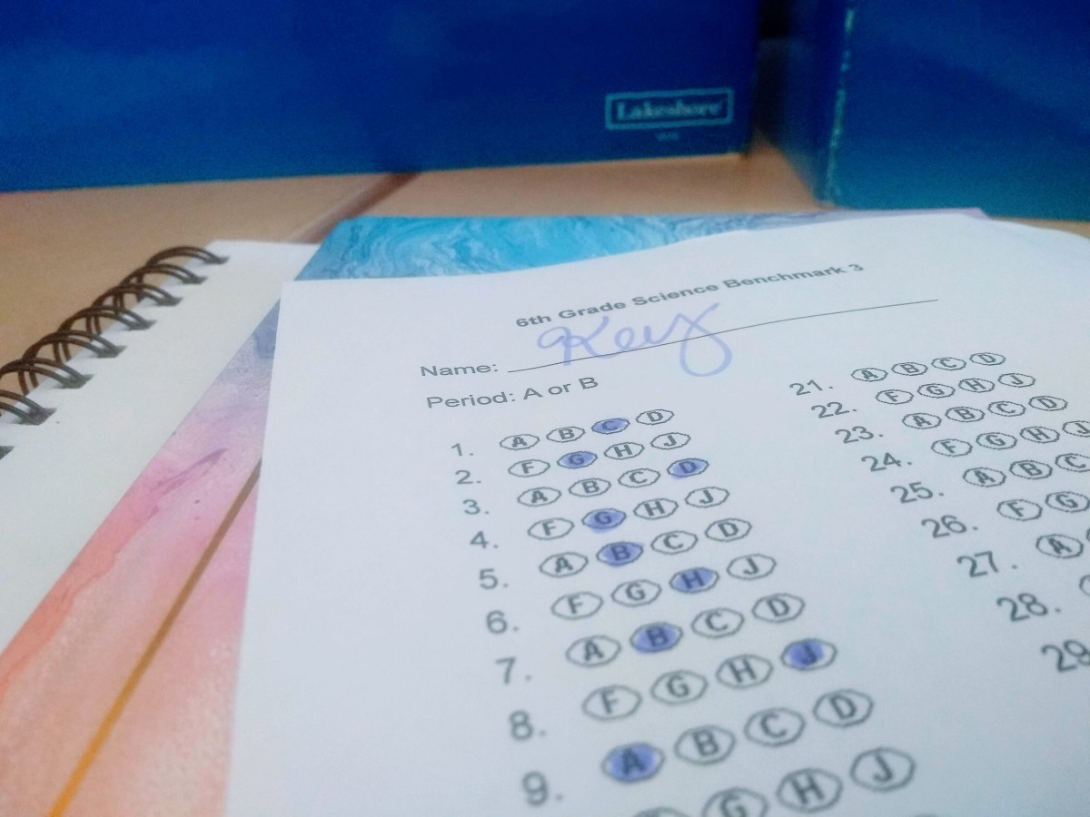
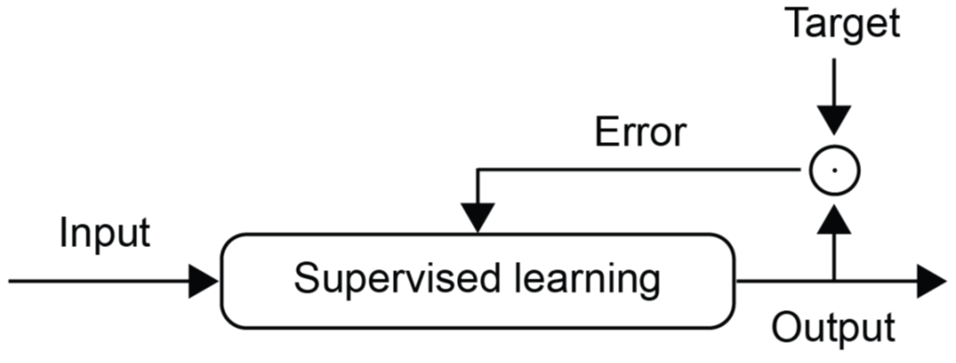
Supervised Learning Logic
Notes:
Alright, let’s take a closer look at the logic for each of our learning types.
With supervised learning, each item in the training dataset has a label (target) attached to it, and the goal of the model is to predict that target. The error, then, is the difference between the model’s prediction and the correct answer (the label or target). So, the goal of the model here is to minimize that error.
The same logic holds true when you take a test. The teacher has a key of the correct answers. And they use that key, in turn, to grade your test responses, deducting full or partial points whenever those do not match the correct answer. This is often called negative reinforcement.
https://sockmonkeyscience.com/2019/02/27/grading-multiple-choice-answer-sheets-quickly/
[NEXT SLIDE]

Slide 13
Supervised Learning Example
Figure 1-1. A labeled training set for spam classification.
Source: Geron, A. (2019). Hands-On Machine Learning w/Scikit-Learn, Keras & Tensorflow . Sebastopol, CA: O'Reilly Media, Inc. (Chapter 1)
Notes:
Consider a spam filter. Classification is a typical supervised learning task, and a spam filter is a good example of this. The model is first trained on a large dataset of emails, tagged as either spam or ham. Once trained, the model can accurately predict which is which. Okay – you may still need to check your spam in-box from time to time!
[NEXT SLIDE]

Slide 14
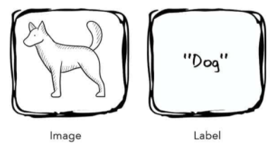
Supervised Learning Example
Source: Taylor, M. (2017). Neural Networks: A Visual Introduction for Beginners. Sebastopol, CA: Blue Windmill Media.
Notes:
To solidify your learning, let’s look at some concrete applications. As stated earlier, supervised learning models work with data that is labelled (annotated). In this example, we present the model with the image of a dog and its label. The label is the correct answer. And through the process of training, the system uses these labels to assess its predictions, correcting and then adjusting itself as it does so. Eventually, the model is fully trained and should make accurate predictions.
[NEXT SLIDE]

Slide 15
Supervised Learning Example
Figure 1-2. A regression problem: predict a value, given an input feature.
Source: Geron, A. (2019). Hands-On Machine Learning w/Scikit-Learn, Keras & Tensorflow . Sebastopol, CA: O'Reilly Media, Inc. (Chapter 1)
Notes:
Another example of a supervised learning task is to predict a target numeric value, such as the price of a car, given a set of features (mileage, age, brand, etc.) called predictors. This sort of task is called regression. To train the system, you need to give it many examples of cars, including both their predictors and their labels (i.e., their prices).
Some other examples of supervised learning algorithms include:
• Linear Regression
• Logistic Regression
• Support Vector Machines (SVMs)
• Decision Trees and Random Forests
• Neural networks
[NEXT SLIDE]
=====
In Machine Learning an attribute is a data type (e.g., “mileage”), while a feature has several meanings, depending on the context, but generally means an attribute plus its value (e.g., “mileage = 15,000”). Many people use the words attribute and feature interchangeably. Feature is used predominantly in the AI literature.

Slide 16
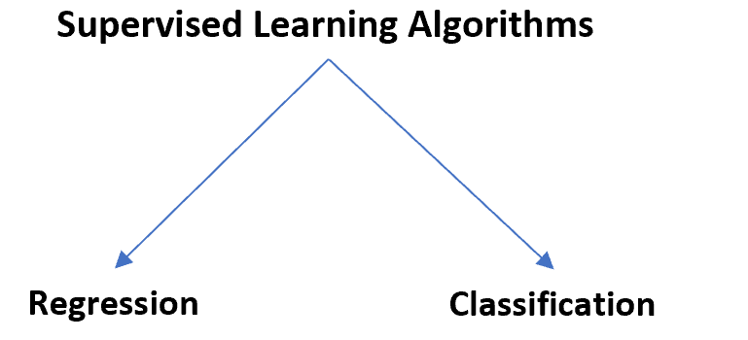

Slide 17
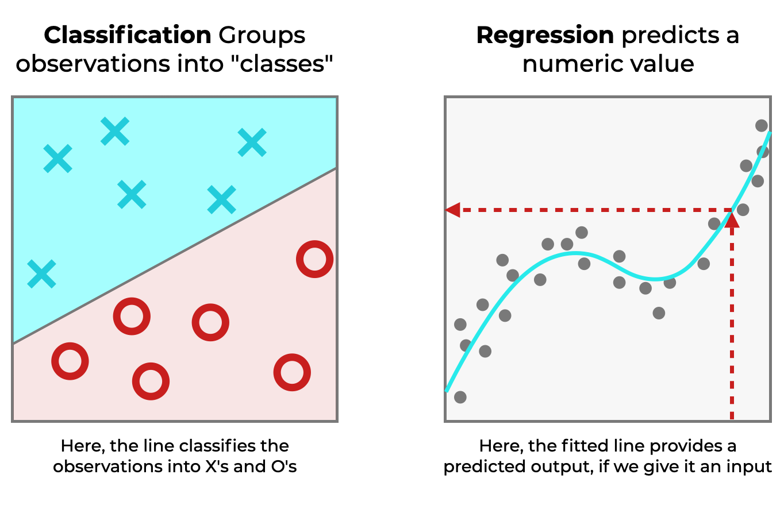

Slide 18
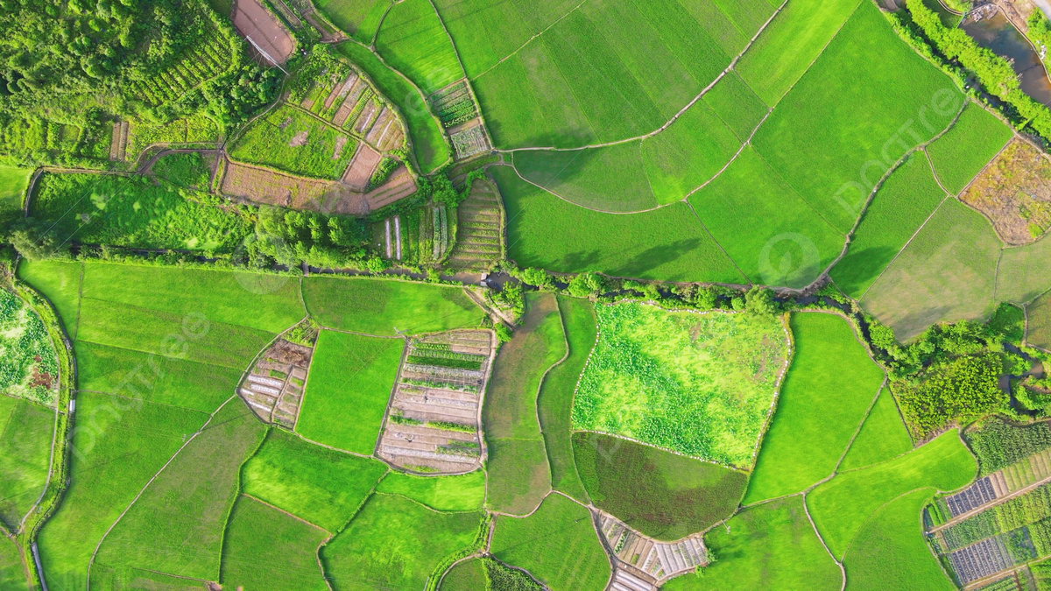
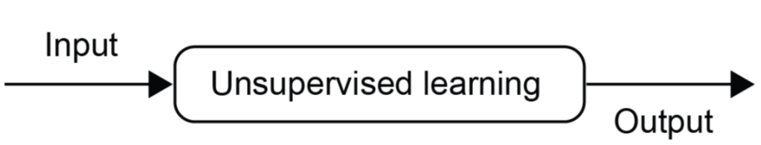
Unsupervised Learning Logic
Notes:
And finally, the logic of unsupervised learning…
Unlike the previous learning types, unsupervised learning has no penalties or rewards. Rather, the goal here is to learn something new, to identify data clusters, to figure out the data’s underlying structure. This is the purest form of learning, learning simply for the sake learning.
Unsupervised learning is like taking pictures of a landscape from a plane, with the goal of discovering the “lay of the land.”
https://pngtree.com/freebackground/aerial-photography-summer-farmland-agriculture-rice_1489332.html
[NEXT SLIDE]

Slide 19
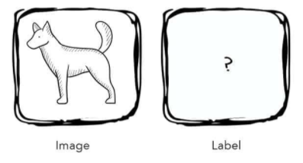
Unsupervised Learning Example
Source: Taylor, M. (2017). Neural Networks: A Visual Introduction for Beginners. Sebastopol, CA: Blue Windmill Media.
Notes:
As noted earlier, an unsupervised learning system discovers hidden patterns in a dataset that is not labelled. In other words, the algorithm is presented with a set of inputs but no correct answers or desired outputs – it must discover the structure and patterns in the data on its own.
[NEXT SLIDE]

Slide 20
Unsupervised Learning Example
Source: Geron, A. (2019). Hands-On Machine Learning w/Scikit-Learn, Keras & Tensorflow . Sebastopol, CA: O'Reilly Media, Inc. (Chapter 1)
Notes:
Consider this dataset. Here we see an unlabeled training dataset of visitors to a popular blog. In this case, we might want to run a clustering algorithm to try and detect groups of similar visitors. Through visual inspection, we can quickly identify at least four groups. But will the AI algorithm be able to mimic this capability?
[NEXT SLIDE]

Slide 21
Unsupervised Learning Example
Source: Geron, A. (2019). Hands-On Machine Learning w/Scikit-Learn, Keras & Tensorflow . Sebastopol, CA: O'Reilly Media, Inc. (Chapter 1)
Notes:
… it appears that a clustering algorithm has in fact detected those four groups, separated by the dashed lines. At no point did we tell the algorithm which group a visitor belongs to: it finds those connections without our help. For example, it might find that 40% of the blog’s visitors are males who love comic books and read the blog in the evening, while 20% are young sci-fi lovers who visit during the weekend.
Let’s consider another unsupervised learning example…
[NEXT SLIDE]

Slide 22
Unsupervised Learning Example
Figure 1-6. Data visualization.
Source: Geron, A. (2019). Hands-On Machine Learning w/Scikit-Learn, Keras & Tensorflow . Sebastopol, CA: O'Reilly Media, Inc. (Chapter 1)
Notes:
Visualization algorithms are also good examples of unsupervised learning systems: you feed them a lot of complex and unlabeled data, and they output a 2D or 3D representation of your data that can be easily plotted. These algorithms try to preserve as much structure as they can so you can understand how the data is organized.
Other examples of unsupervised learning algorithms include:
• Clustering
• Anomaly detection and novelty detection
• Visualization and dimensionality reduction
• Association rule learning
[NEXT SLIDE]

Slide 23
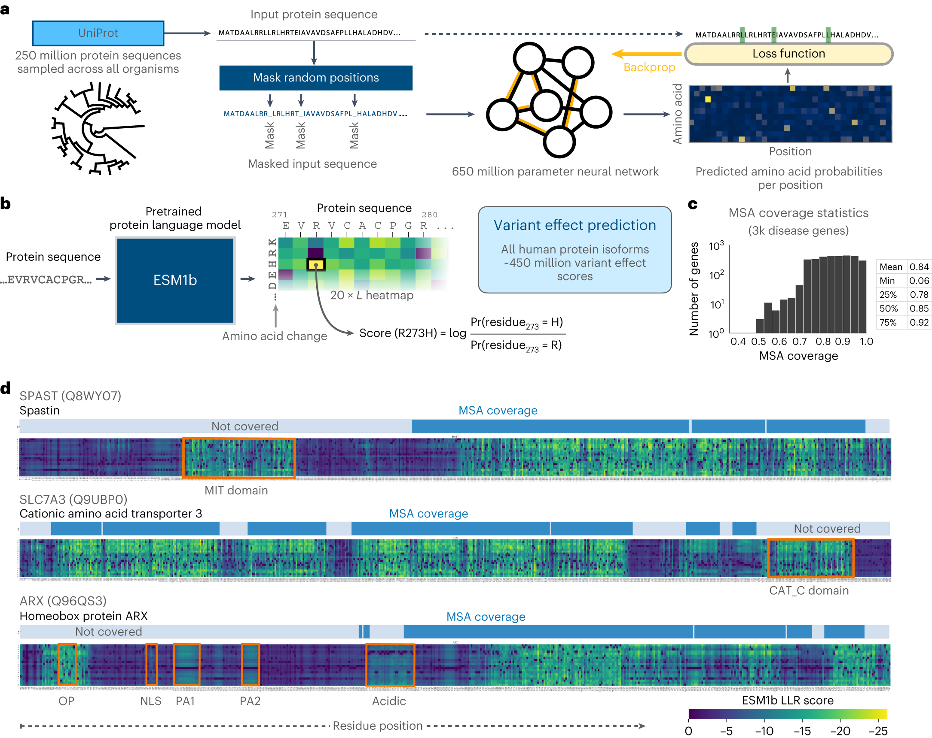
https://doi.org/10.1038/s41588-023-01465-0

Slide 24
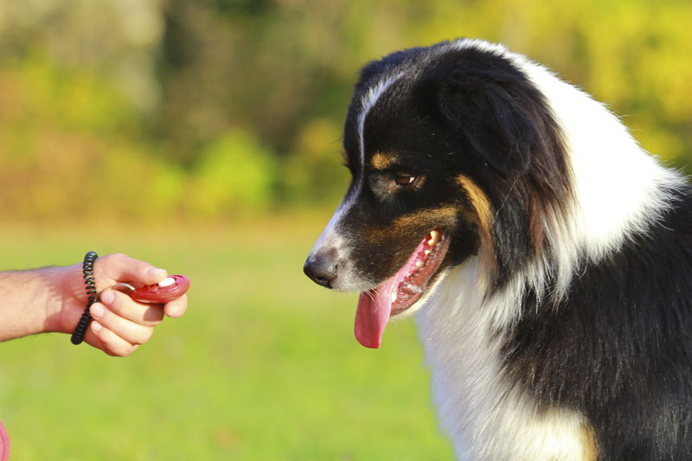
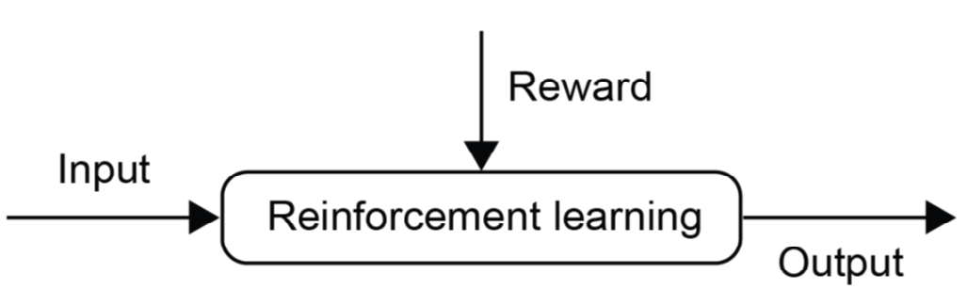
Reinforcement Learning Logic
Notes:
Moving on to the logic of Reinforcement learning…
With reinforcement learning, the goal is to maximize the rewards for doing the right thing. The logic here is the opposite of supervised learning. Rather than minimize the error, the system seeks to maximize the reward. This is also known as positive reinforcement.
Think animal clicker training. For example, a dog will quickly figure out that a behavior, followed by a click, results in a delicious treat. For Fido, the training objective is simple – Maximize the treats in this environment!
B. F. Skinner’s operant conditioning is the intellectual antecedent of reinforcement learning. The two are very similar.
https://www.companionanimalpsychology.com/2016/09/clicker-training-vs-treat-equally-good.html
[NEXT SLIDE]

Slide 25
Reinforcement Learning Example
Source: Geron, A. (2019). Hands-On Machine Learning w/Scikit-Learn, Keras & Tensorflow . Sebastopol, CA: O'Reilly Media, Inc. (Chapter 1)
Notes:
Reinforcement Learning is a very different beast. This type of learning system features an agent who observes the environment, selects and performs actions, and is then rewarded or penalized for each action. On its own, the agent must discover the best strategy, called a policy, to get the most reward over time. A policy defines what action the agent should choose when it is in a particular situation.
For example, many robots implement Reinforcement Learning algorithms to learn how to walk. DeepMind’s AlphaGo program is another example of Reinforcement Learning: it made the headlines in May 2017 when it beat the world champion at the game of Go. It learned its winning policy by analyzing millions of games, and then playing many games against itself.
[NEXT SLIDE]

Slide 26
Detecting and Classifying Dogs and Cats in an Image
What kind of learning is it?
Supervised
Unsupervised
Reinforcement
Source: Palmas, A. (2019). The Reinforcement Learning Workshop. Birmingham, UK: Packt Publishing. (Chapter 1)
Notes:
Alright, let’s take a short quiz. First question – what kind of learning this? This model classifies dogs and cats in an image. Select an answer now. This is an example of supervised learning.
Why Not Unsupervised Learning?
Here we have a determined output given an input (an image). We do not want to extract unknown patterns in the data.
Why Not RL?
Detection and classification are not tasks that are suited to the RL framework. We do not have a set of actions the agent should take to solve a problem. Also, in this case, the sequential structure is absent.
[NEXT SLIDE]

Slide 27
Identifying Clusters in a Dataset
What kind of learning is it?
Supervised
Unsupervised
Reinforcement
Source: Palmas, A. (2019). The Reinforcement Learning Workshop. Birmingham, UK: Packt Publishing. (Chapter 1)
Notes:
Question number two. What kind of learning is this? This model identifies clusters in a dataset. Select an answer now. This is an example of unsupervised learning.
Here the original data is on the left. And on the right, we see the possible output of a clustering algorithm like principal component analysis (PCA). Different colors denote different clusters. PCA, by the way, is an unsupervised algorithm used for dimensionality reduction and feature extraction.
[NEXT SLIDE]

Slide 28
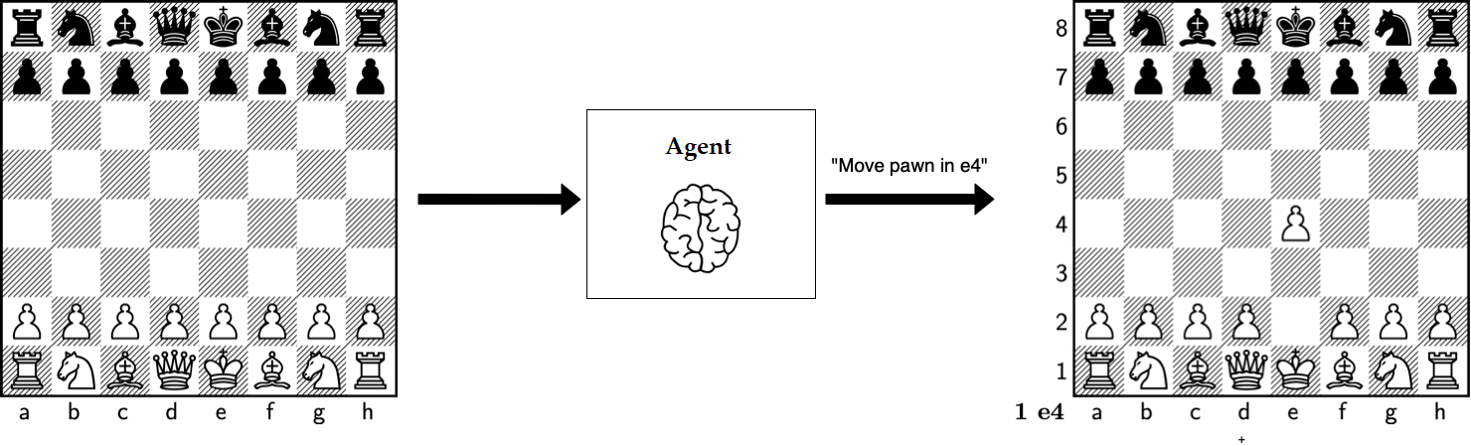
Playing Chess
What kind of learning is it?
Supervised
Unsupervised
Reinforcement
Source: Palmas, A. (2019). The Reinforcement Learning Workshop. Birmingham, UK: Packt Publishing. (Chapter 1)
Notes:
And a final question. What kind of learning is this? This model has learned to play chess. Select an answer now. Playing chess is a reinforcement learning application. The program can perceive the current state of the board (for example, the positions and types of pawns), and, based on that, it decides which action to take.
Why Not Supervised?
We can think of playing chess as a supervised learning problem, but we would need to have a dataset, and we should incorporate the sequential structure of the game into the supervised learning problem.
Why Not Unsupervised?
Unsupervised learning does not fit this problem as we are not dealing with learning a representation of the data; we have a defined objective, which is winning the game.
[NEXT SLIDE]

Slide 29
Predicting cancer risk based genomic sequences
What kind of learning is it?
Supervised
Unsupervised
Reinforcement
Source: Palmas, A. (2019). The Reinforcement Learning Workshop. Birmingham, UK: Packt Publishing. (Chapter 1)
Notes:
And a final question. What kind of learning is this? This model has learned to play chess. Select an answer now. Playing chess is a reinforcement learning application. The program can perceive the current state of the board (for example, the positions and types of pawns), and, based on that, it decides which action to take.
Why Not Supervised?
We can think of playing chess as a supervised learning problem, but we would need to have a dataset, and we should incorporate the sequential structure of the game into the supervised learning problem.
Why Not Unsupervised?
Unsupervised learning does not fit this problem as we are not dealing with learning a representation of the data; we have a defined objective, which is winning the game.
[NEXT SLIDE]

Slide 30
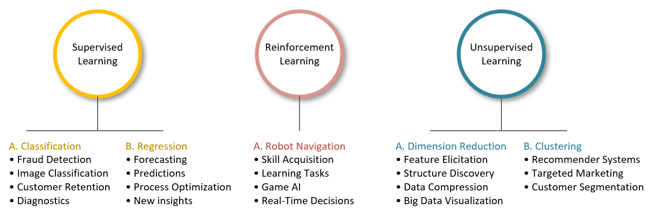
Applications
Notes:
This image shows some of the ways AI is being used today.
We present this information because background knowledge is key to helping you imagine AI possibilities in your domain. Naturally, the challenge is to take an application in one area and modify it, so it works in yours. I believe this is where a lot of innovation will happen in the near future. Please see the Optional Content / Additional Resources sections of each module for more information about AI applications.
[NEXT SLIDE]

Slide 31
The supervised learning paradigm

Slide 32
Cat or Dog?
Mathematical function mapping image to label (“cat” or “dog”)
cat
Notes:
Our bottom-up example will be a simple classification task – Is this an image of a dog or a cat?
We start with a mathematical function capable of mapping an image to its corresponding label.
We then present the function with an image and it, in turn, responds
with a prediction – that this image is a cat.
-- Slow down the word image…

Slide 33
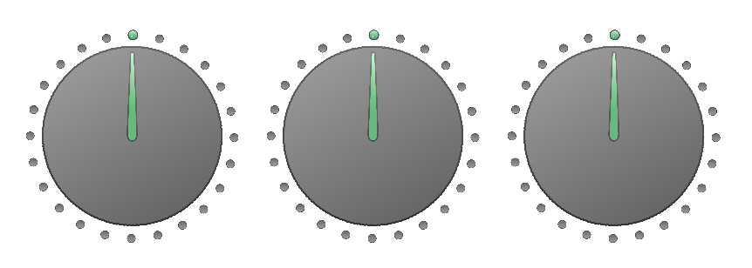
Cat or Dog?
Mathematical function mapping image to label (“cat” or “dog”)
E.g.: y = mx + b
Special numerical values in the function are “knobs” we can turn to adjust the outputs.
Notes:
Okay – let’s clear the decks and take a closer look at our function.
First, we add a set of knobs which, in turn,
… allow us to adjust the way the function operates, including its outputs.
And here’s an example – a simple linear function…
… with adjustable parameters.
-- More time with adjustable parameters

Slide 34
Cat or Dog?
Mathematical function mapping image to label (“cat” or “dog”)
Notes:
Let’s reset everything once again and step through a concrete example of the training process. Now in the field of AI, the mathematical function is often called the model and the knobs are parameters or hyperparameters, depending on the scope of control. A parameter is internal to the model whereas a hyperparameter (for example, the learning rate) is external, set directly when the model is defined.
-- Slow down learning rate, emphasize the ‘t’

Slide 35
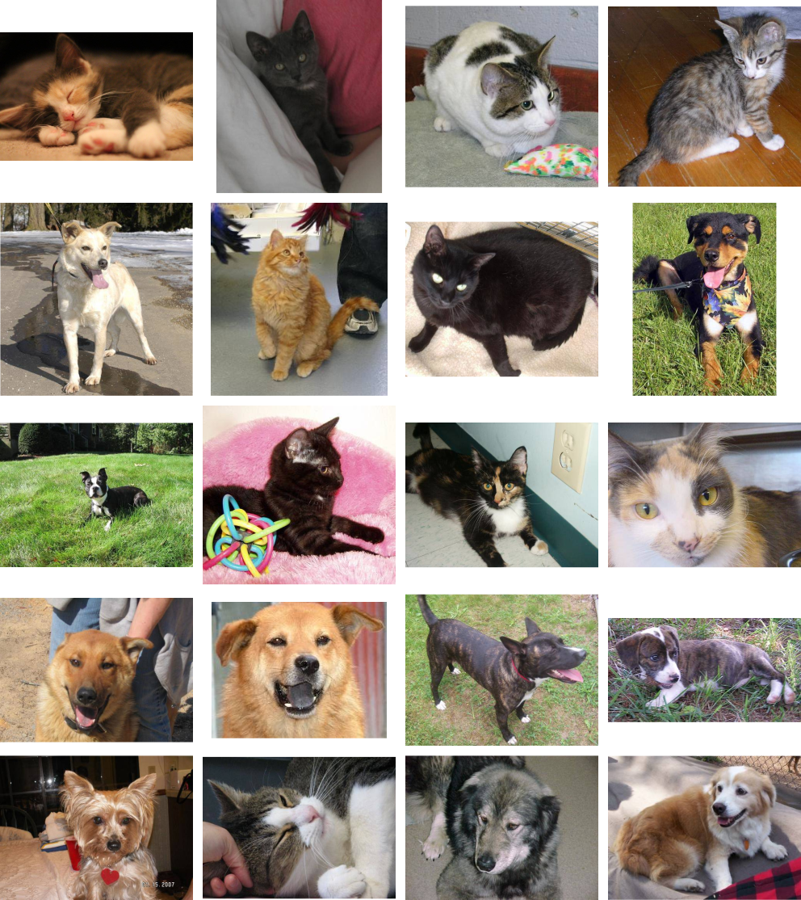
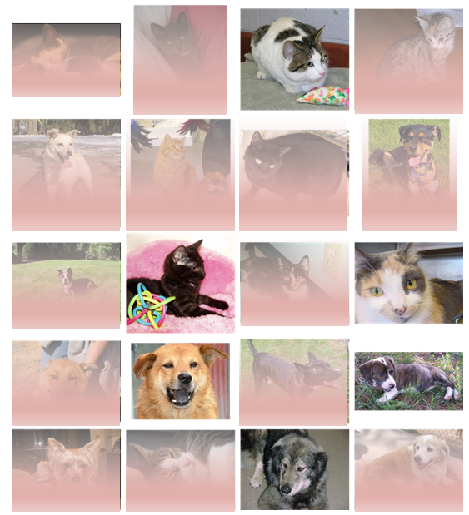
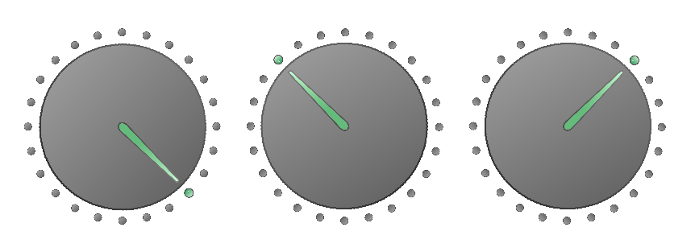
Cat or Dog?
Mathematical function mapping image to label (“cat” or “dog”)
Training algorithm
Notes:
The training process begins by initializing our parameters to random values.
A set of images is fed to the function with a ‘dog’ or ‘cat’ label attached to each. The function then classifies the image – this is a ‘dog’ or this is a ‘cat’.
As we can see, most of the predictions are wrong in this initial training iteration (epoch), with the images in red being incorrectly classified.
This performance information is then sent back to the training algorithm…
… which adjusts the knobs or parameters.

Slide 36
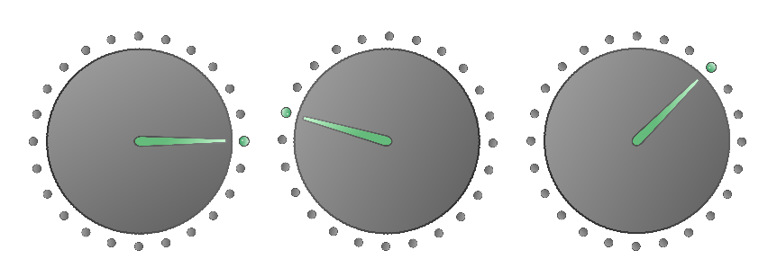
Cat or Dog?
Mathematical function mapping image to label (“cat” or “dog”)
Training algorithm
Notes:
… with our parameters adjusted, we’re ready to execute another training cycle (epoch).

Slide 37
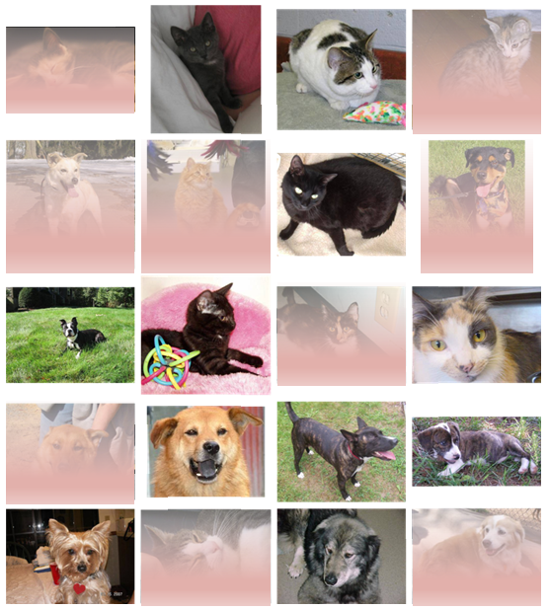
Cat or Dog?
Mathematical function mapping image to label (“cat” or “dog”)
Training algorithm
Notes:
… and we start the process again.
The cat and dog images are fed to the function.
The function classifies the images. Well, this looks promising. More of the images are correctly classified. That is, we see less red shading.
Performance feedback is once again sent to the training algorithm
… which, in turn, adjusts the knobs or parameters.

Slide 38
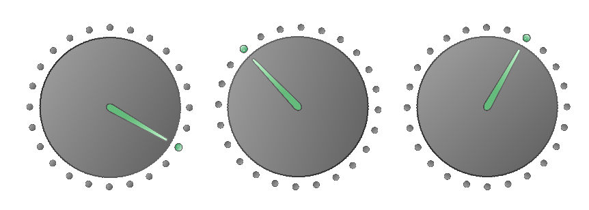
Cat or Dog?
Mathematical function mapping image to label (“cat” or “dog”)
Training algorithm
Notes:
… with our parameters adjusted, we’re ready to execute another epoch.

Slide 39
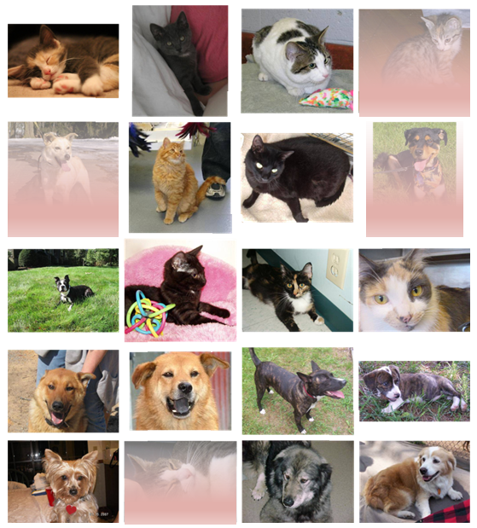
Cat or Dog?
Mathematical function mapping image to label (“cat” or “dog”)
Training algorithm
Notes:
… and off we go again.
The cat and dog images are fed to the function.
Well, it looks like our training algorithm has done a good job adjusting the model’s parameters. This is certainly a big improvement over our first round (epoch) of training. Most of the images are now correctly classified.
Once again, performance feedback is sent to the training algorithm
… which adjusts the knobs. At this point, we could continue to train the model. But eventually, we arrive at a point where it’s as good as it will ever get, and further training is pointless.

Slide 40
Simplest supervised learning - linear regression with one variable

Slide 41
Task: Fit a model to predict house prices
Housing Prices
(Portland, OR)
Price
(in 1000s of dollars)
Size (feet²)

Slide 42
Housing Prices
(Portland, OR)
Price
(in 1000s of dollars)
Size (feet²)
Supervised Learning
Given the “right answer” for each example in the data.
Regression Problem
Predict real-valued output

Slide 43
Training set of
housing prices
(Portland, OR)
Size in feet² (x) | Price ($) in 1000's (y)
2104 | 460
1416 | 232
1534 | 315
852 | 178
… | …
Notation:
m = Number of training examples
x’s = “input” variable / features
y’s = “output” variable / “target” variable

Slide 44

Training Set
How do we represent h ?
Learning Algorithm
Size of house
h
Estimated price
Linear regression with one variable.
Univariate linear regression.

Slide 45
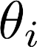
Training Set
Size in feet² (x) | Price ($) in 1000's (y)
2104 | 460
1416 | 232
1534 | 315
852 | 178
… | …
Hypothesis:
‘s: Parameters

Slide 46
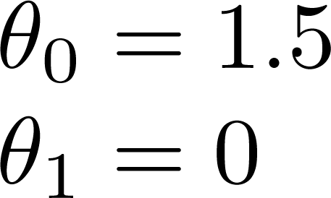
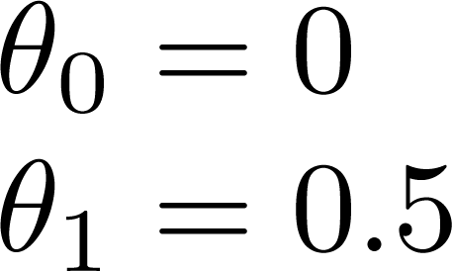
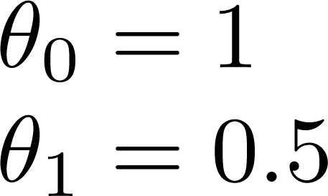

Slide 47
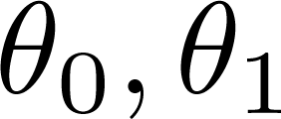
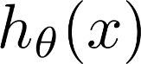
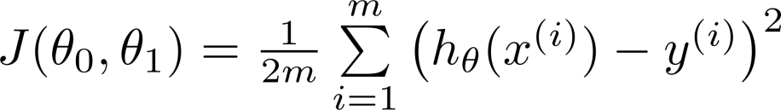
How to choose the model parameters?
Idea: Choose so that is close to for our training examples
y
x
Cost function:

Slide 48
Introducing the cost function
Cost function measures how well the model fits the training data given the model parameters
y
Mean squared error (MSE)
x
Measures the mean squared distance between the true labels and the predictions

Slide 49
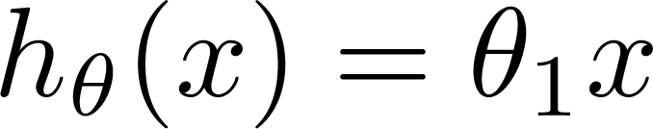
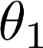
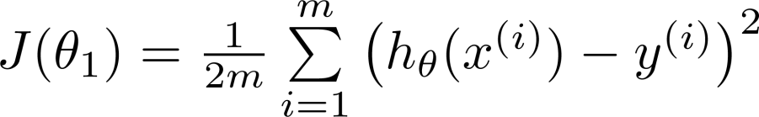
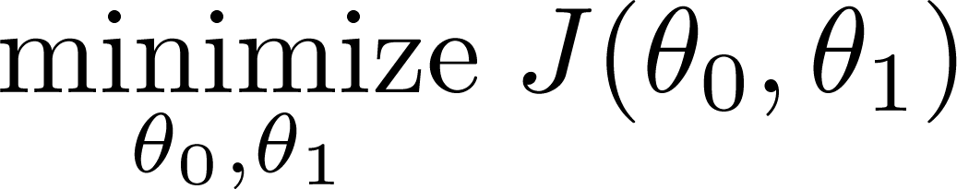
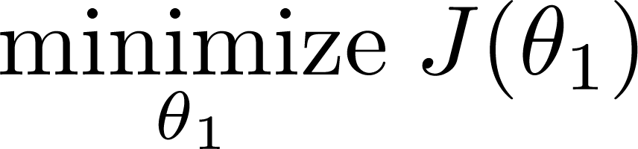
Simplified
Hypothesis:
Parameters:
Cost Function:
Goal:

Slide 50
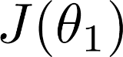
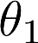
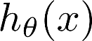
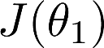
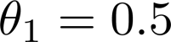
(for fixed , this is a function of x)
(function of the parameter )
y
x

Slide 51
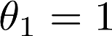
(for fixed , this is a function of x)
(function of the parameter )
y
x

Slide 52
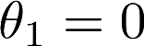
(for fixed , this is a function of x)
(function of the parameter )
y
x

Slide 53
(for fixed , this is a function of x)
(function of the parameter )
y
x

Slide 54
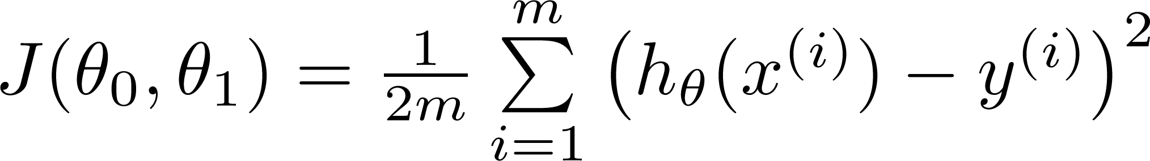
Bringing back the intercept parameter
Hypothesis:
Parameters:
Cost Function:
Goal:

Slide 55
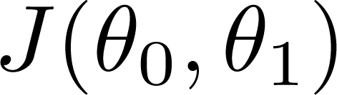
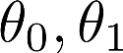
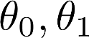

(for fixed , this is a function of x)
(function of the parameters )
Price ($)
in 1000’s
Size in feet² (x)

Slide 56


Slide 57


(for fixed , this is a function of x)
(function of the parameters )

Slide 58


(for fixed , this is a function of x)
(function of the parameters )

Slide 59


(for fixed , this is a function of x)
(function of the parameters )

Slide 60


(for fixed , this is a function of x)
(function of the parameters )

Slide 61
How to find the best model parameters?
For simple cases, one may find the optimal model parameters analytically (i.e. through calculus)
How ever in most cases, this is not possible

Slide 62

Have some function
Want
Outline:
Start with some
Keep changing to reduce until we hopefully end up at a minimum

Slide 63

Introducing gradient decent
J(θ₀,θ₁)
θ₁
θ₀

Slide 64

J(θ₀,θ₁)
θ₁
θ₀

Slide 65




Gradient descent algorithm
Correct: Simultaneous update
Incorrect:

